Slide 1
Word Embedding and the Beyond
Benyou Wang
University of Padova

Slide 2
Contents
What embedding is and why
History
Trends of word embedding
Pretrained word embedding
Subword
Meta-embedding
Word embedding in dynamics
Two examples
Our ideas

Slide 3




What does “embed” means?

Slide 4
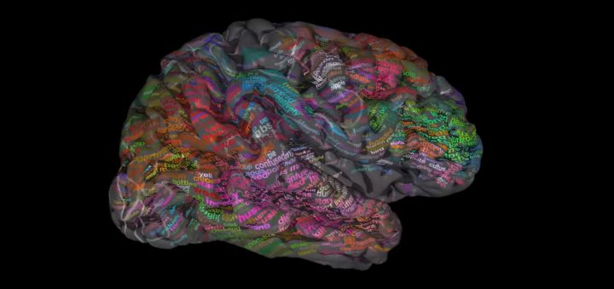
Huth, A.G., de Heer, W.A., Griffiths, T.L., Theunissen, F.E., Gallant, J.L., 2016. Natural speech reveals the semantic maps that tile human cerebral cortex. Nature 532, 453–458. doi:10.1038/nature17637
http://gallantlab.org/huth2016/

Slide 5
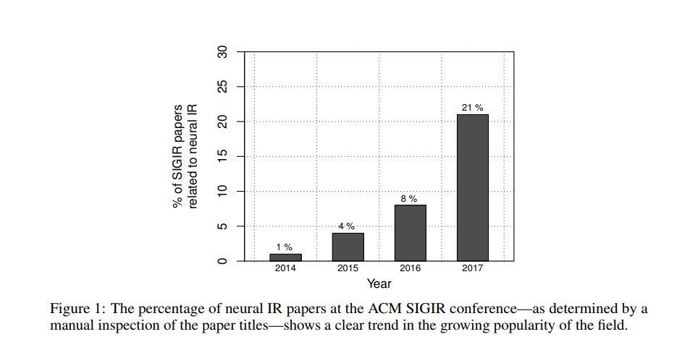
Trends for Neural IR
Mitra B, Craswell N. Neural Models for Information Retrieval[J]. arXiv preprint arXiv:1705.01509, 2017.

Slide 6
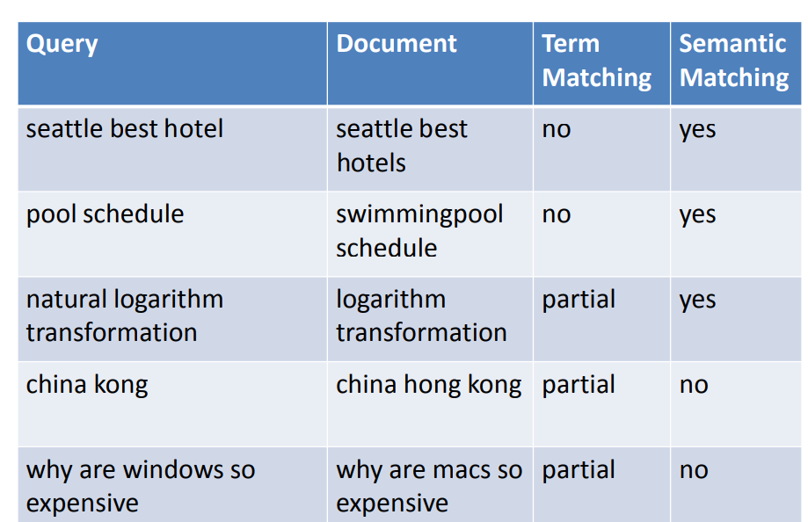
Example of Mismatch
Hang li, http://www.hangli-hl.com/uploads/3/4/4/6/34465961/tsinghua_opportunities_and_challenges_in_deep_learning_for_information_retrieval.pdf

Slide 7
Localist representation
Size color … unknown
[.3, .7, .2, .1, .5]
[.5, .3, .2, .1, .0]
[.2, .0, .31, .03, .01]
[.1, .1, .5, .5, 0.2]
BMW [1, 0, 0, 0, 0]
Audi [0, 0, 0, 1, 0]
Benz [0, 0, 1, 0, 0]
Polo [0, 0, 0, 1, 0]
http://www.cs.toronto.edu/~bonner/courses/2014s/csc321/lectures/lec5.pdf

Slide 8
Distributed representation
Size color … unknown
[.3, .7, .2, .1, .5]
[.5, .3, .2, .1, .0]
[.2, .0, .31, .03, .01]
[.1, .1, .5, .5, 0.2]
BMW [1, 0, 0, 0, 0]
Audi [0, 0, 0, 1, 0]
Benz [0, 0, 1, 0, 0]
Polo [0, 0, 0, 1, 0]

Slide 9
Embedding
Distributional hypothesis
linguistic items with similar distributions have similar meanings
imaginary
Complex
Real
Life is complex. It has both real and imaginary parts
https://en.wikipedia.org/wiki/Distributional_semantics

Slide 10
How to get Distributed representation
Matrix Factorization
Word-word Matrix
Document-word Matrix
PLSA
LDA
Sample-based Prediction
NNLM
C & W
Word2vec
Glove is a combination between these two schools of approaches
Levy, Omer, and Yoav Goldberg. "Neural word embedding as implicit matrix factorization." Advances in neural information processing systems. 2014.

Slide 11
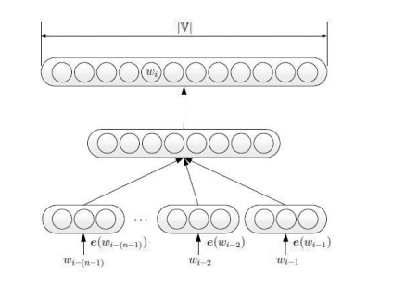
NNLM to Word2vec
Negative sampling
Hierarchical softmax
Concat -> mean
Bengio Y, Ducharme R, Vincent P, et al. A neural probabilistic language model[J]. Journal of machine learning research, 2003, 3(Feb): 1137-1155.
Mikolov T, Chen K, Corrado G, et al. Efficient estimation of word representations in vector space[J]. arXiv preprint arXiv:1301.3781, 2013.

Slide 12
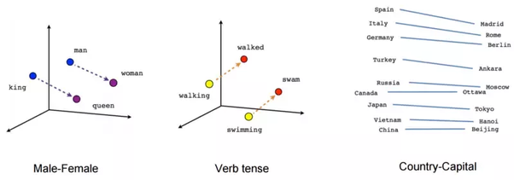
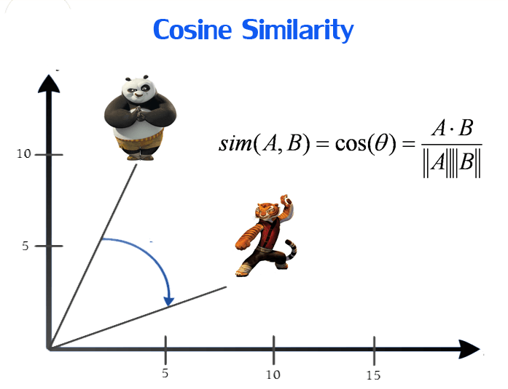
Advantage of word embedding
Linguistic regulation
$\vec{king} − \vec{man}$ = $\vec{queen}$ - $\vec{woman}$
Semantic matching
As the initial input Feature/Weight for NN

Slide 13
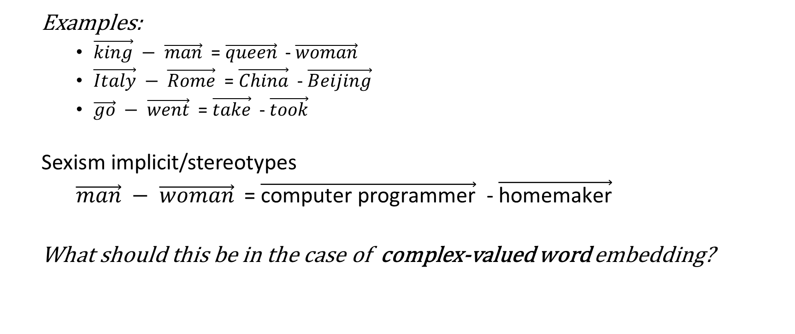
Side effect – Additivity compositionality
Examples:
$\vec{king} − \vec{man}$ = $\vec{queen}$ - $\vec{woman}$
$\vec{Italy} − \vec{Rome}$ = $\vec{China}$ - $\vec{Beijing}$
$\vec{go} − \vec{went}$ = $\vec{take}$ - $\vec{took}$
Sexism implicit/stereotypes
$\vec{man} − \vec{woman}$ = $\vec{\text{computer} \text{programmer}}$ - $\vec{\text{homemaker}}$
What should this be in the case of complex-valued word embedding?
Gittens A, Achlioptas D, Mahoney M W. Skip-gram-zipf+ uniform= vector additivity[C]// ACL. 2017, 1: 69-76.

Slide 14
Problems
Noise
Trained with neural network
OOV
Subword information
Multi-sense/Polysemy
Semantic composition
Beyond real-valued vector
Complex-valued
Gaussian Embedding
Bias
Corpus-sensitive
Elmo/Bert
Non-static
http://ruder.io/word-embeddings-2017/

Slide 15
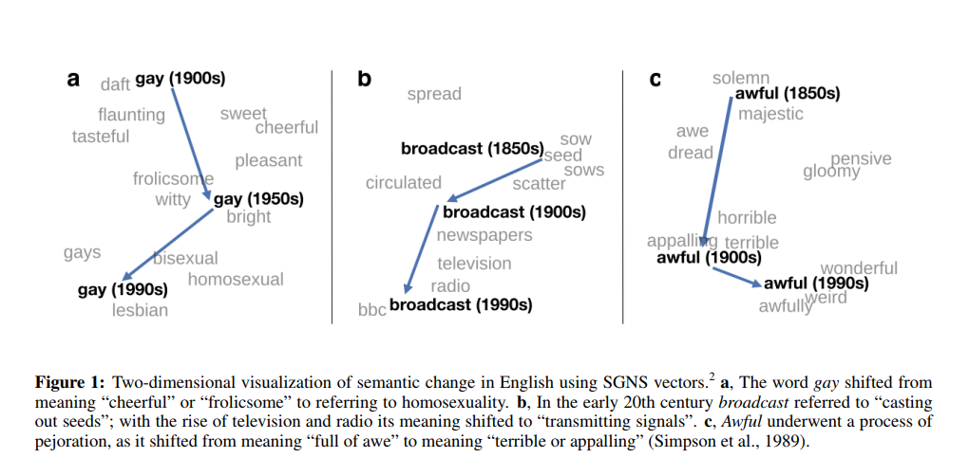
ACL 2016
Hamilton W L, Leskovec J, Jurafsky D. Diachronic Word Embeddings Reveal Statistical Laws of Semantic Change[C]// ACL. 2016, 1: 1489-1501.
https://github.com/williamleif/histwords

Slide 16
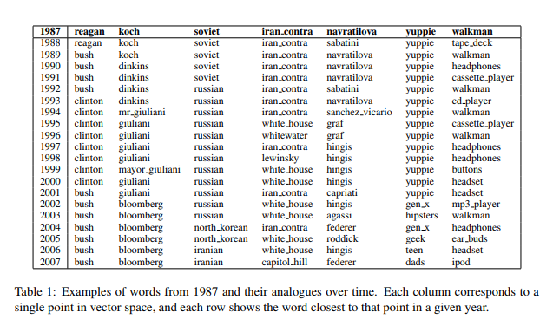
ACL 2017
Szymanski, T. (2017). Temporal Word Analogies : Identifying Lexical Replacement with Diachronic Word Embeddings. ACL (pp. 448–453).

Slide 17
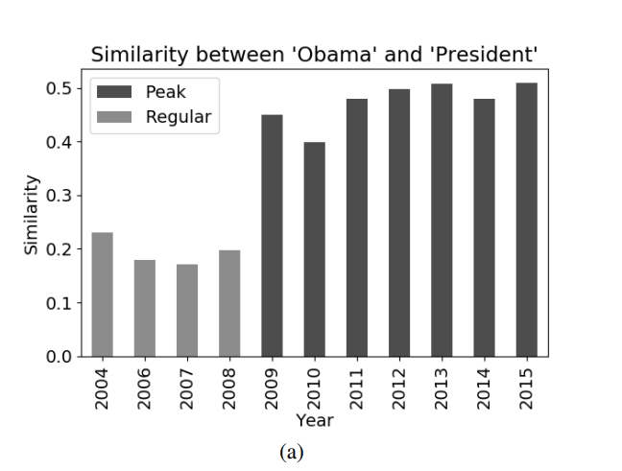
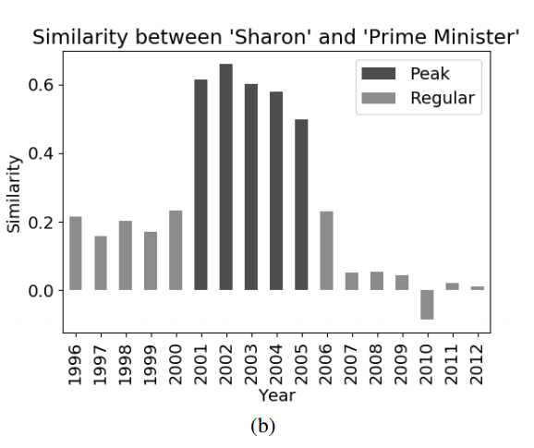
EMNLP 2017 Word Relatedness over Time
Similarity identified by the algorithms between words over time. Dark gray indicates high similarity whereas light gray indicates nonsignificant similarity
Rosin, G., Radinsky, K., & Adar, E. (2017). Learning Word Relatedness over Time. EMNLP.

Slide 18
EMNLP 2017-Laws of semantic change
The Law of Conformity
which frequency is negatively correlated with semantic change
The Law of Innovation
which polysemy is positively correlated with semantic change
The Law of Prototypicality
which prototypicality is negatively correlated with semantic change
Dubossarsky, H., Grossman, E., & Weinshall, D. (2017). Outta Control: Laws of Semantic Change and Inherent Biases in Word Representation Models. EMNLP(pp. 1147–1156).

Slide 19
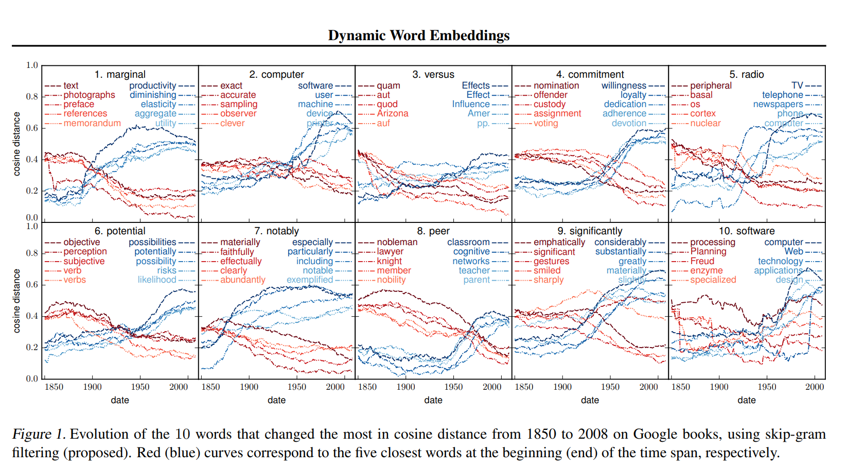
ICML 2017 –dynamic Word embedding
Bamler R, Mandt S. Dynamic Word Embeddings[C]// ICML. 2017: 380-389.

Slide 20
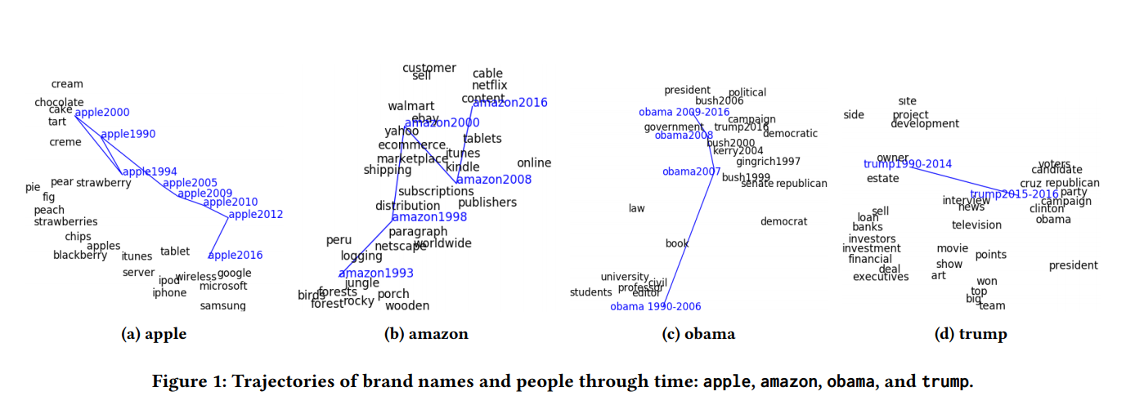
WSDM 2018 - evolving semantic discovery
Yao Z, Sun Y, Ding W, et al. Dynamic word embeddings for evolving semantic discovery[C]// WSDM. ACM, 2018: 673-681.

Slide 21
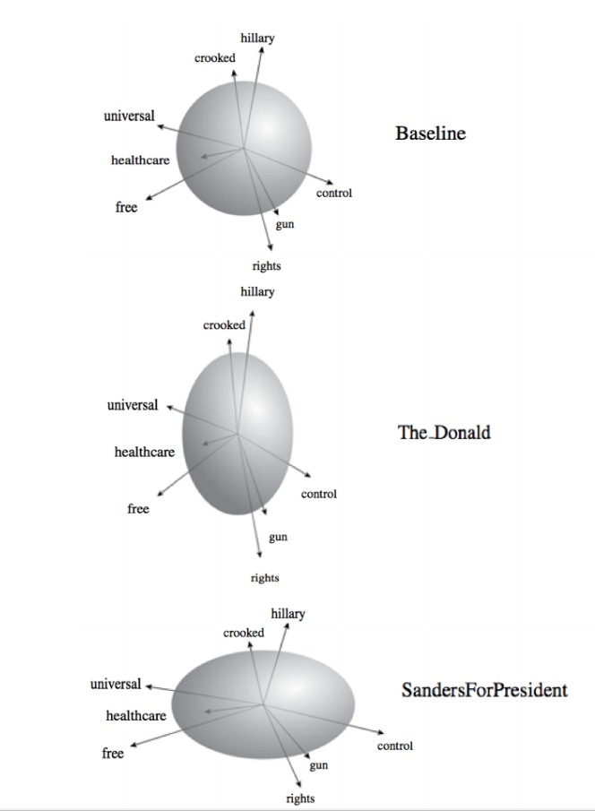
ICML
Tian K, Zhang T, Zou J. CoVeR: Learning Covariate-Specific Vector Representations with Tensor Decompositions[J]. ICML 2018, 2018.

Slide 22
Lack of reasonable benchmark for evaluation
Reason:
Hard to find annotators from 10 years ago
The ground truth is a little bit subjective

Slide 23
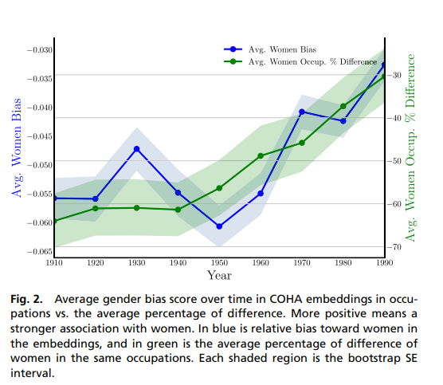
The changing stereotype over time
Bolukbasi T, Chang K W, Zou J Y, et al. Man is to computer programmer as woman is to homemaker? debiasing word embeddings[C]//NIPS. 2016: 4349-4357.
Garg N, Schiebinger L, Jurafsky D, et al. Word embeddings quantify 100 years of gender and ethnic stereotypes[J]. Proceedings of the National Academy of Sciences, 2018, 115(16): E3635-E3644.

Slide 24
Linking embedding with topic/thematic issue
For a topic, it is usually considered as a distribution of words
$p^{(i)}=p(p_{w_{1}},p_{w_{1}},…p_{w_{|v|}})$
For a word embedding, its neighbor has a well-designed distance, we could also get a distribution as $p_{w_{j}}= \frac{e^{d_{ij}}}{∑e_{}^{d_{ij}}}$.
In a sense, word embedding is considered lower-level topic
Word embedding
Topic
Thematic issue

Slide 25
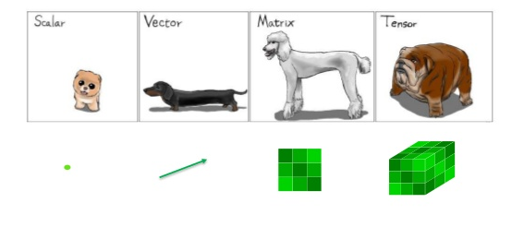
Dynamics
Concatenate the Document-Term or Term-Term Co-occurrence as a Tensor
$[{M_{t}}_{1},{M_{t}}_{2},…,{M_{t}}_{T}]$ as $T_{t,d,w},$ 3-d Tensor, where ${M_{t}}_{1}$ is the D-W matrix.
Tensor composition/factorization machine for time-aware word embedding
Obtain the neighbor words of “nuclear” in different time stamp.

